Slide 1
360 Virtual Tour
Guide:
Dr. S. Chitrakala,
Professor- DCSE,
Director - CIT,
CEG, Anna University
Ms. M. S. Karthika Devi,
Deputy Director - CIT,
Asst. Professor - DCSE
CEG, Anna University
Team Members:
Srihari S.,
UG 2021-2025, DME CEG, Anna University
Rushil A Krishnan,
UG 2021-2025, DCSE CEG, Anna University
Industry Mentor:
Mr. Senthamizh,
XR Consultant, The DreamX, Chennai

Slide 2
Objectives
To provide an immersive tour of CEG campus, Anna University.
To make the tour available in various platforms such as mobile, PC.
To make the functionality seamless and lag free.
To provide information to the user about each location they visit to make it feel like a guided tour across College of Engineering Guindy Campus, Anna University.

Slide 3
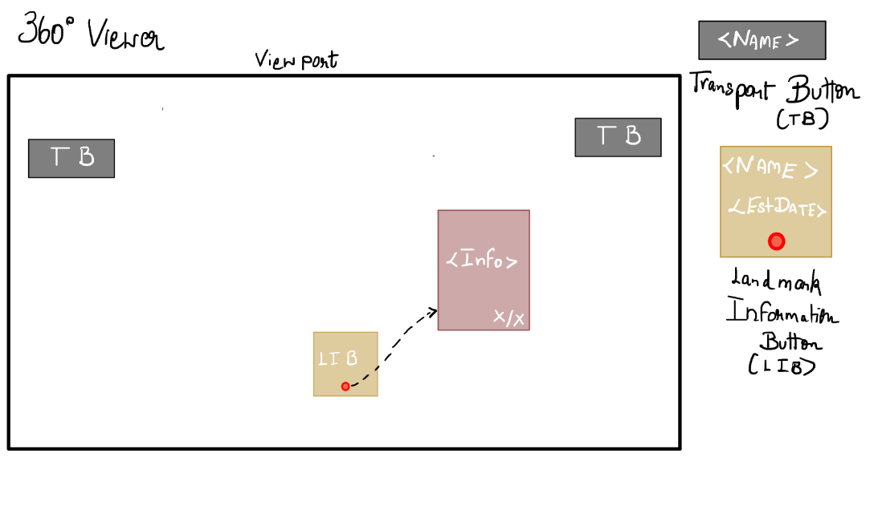
Storyboard
The above story board was created during the beginning of the project development to give a baseline on the type of platform that the user shall experience when using the webapp.

Slide 4
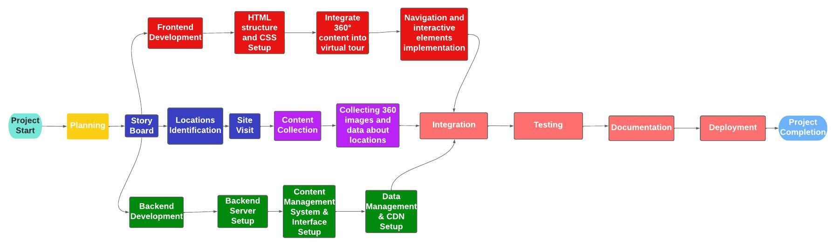
Flow of Work

Slide 5
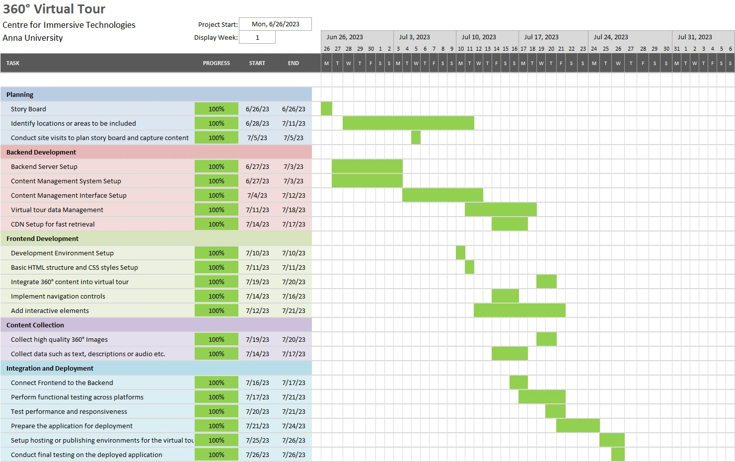
Project Timeline

Slide 6
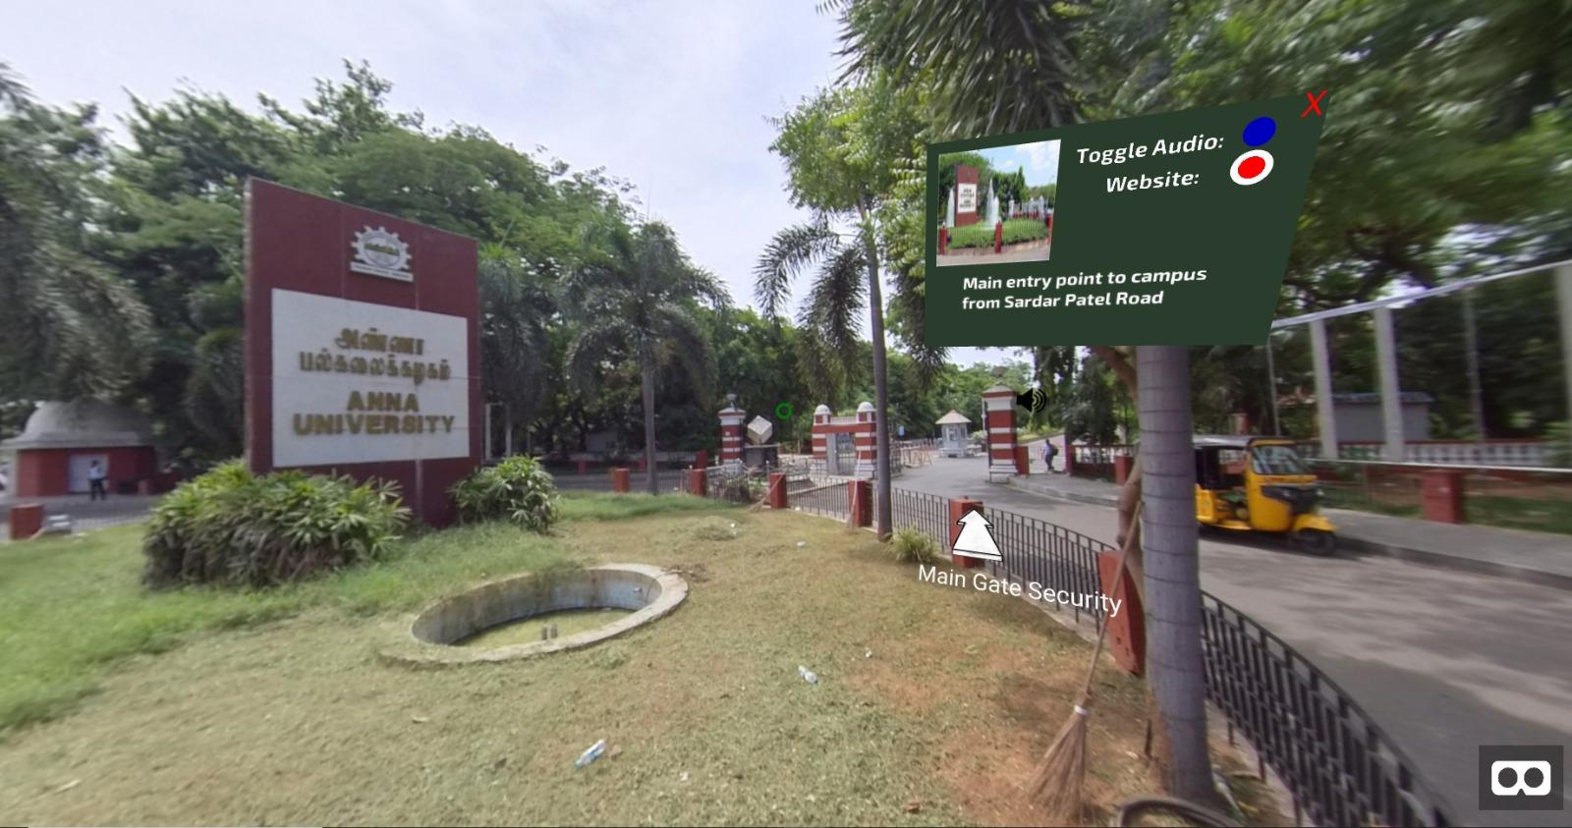
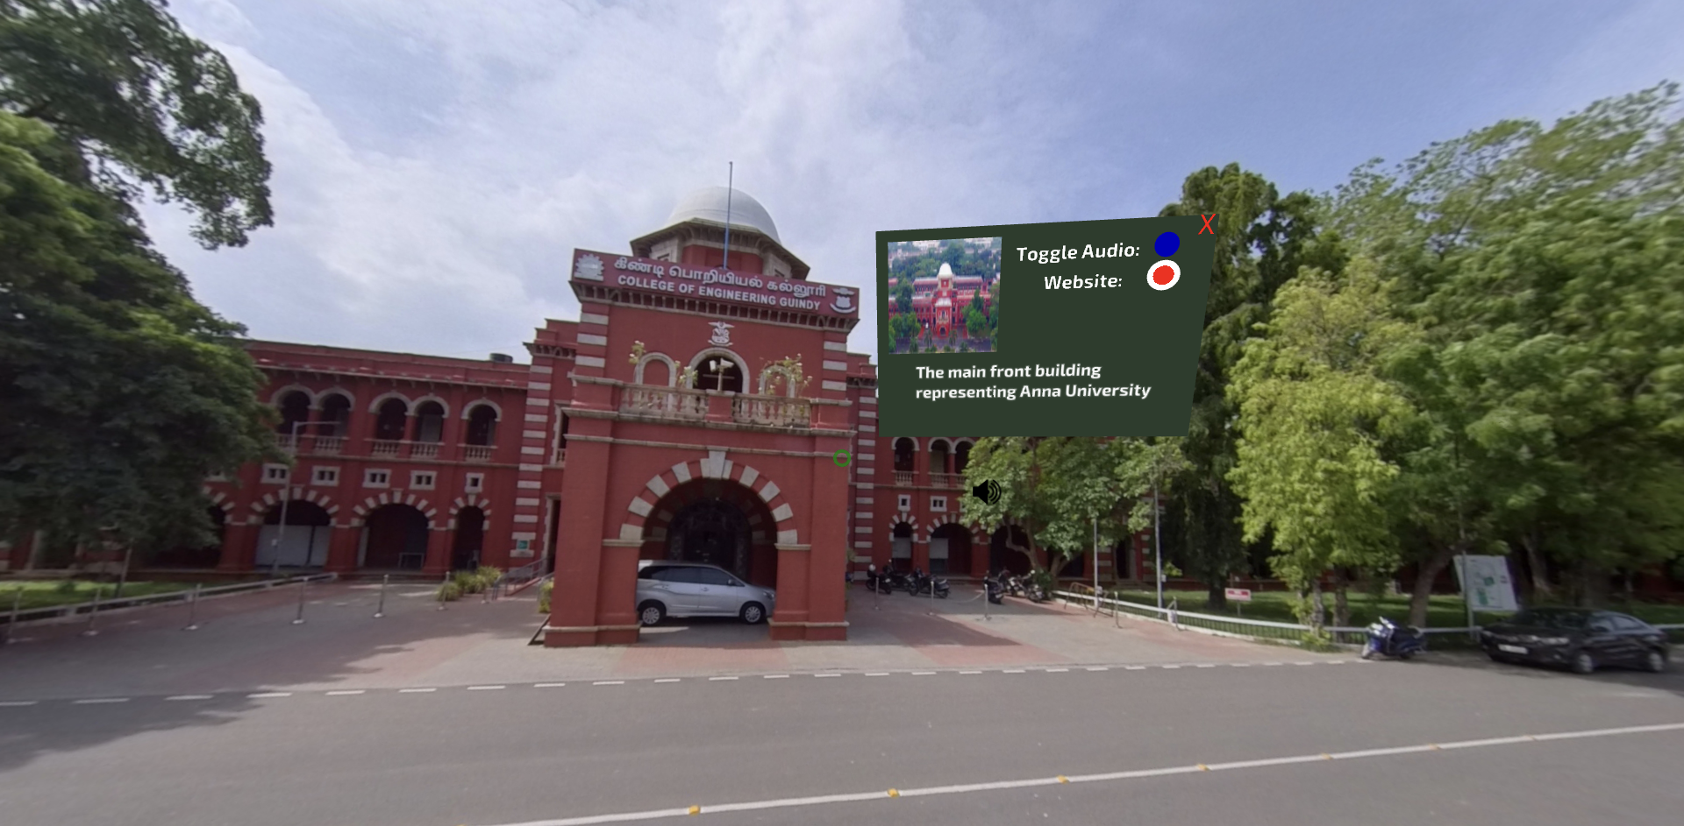
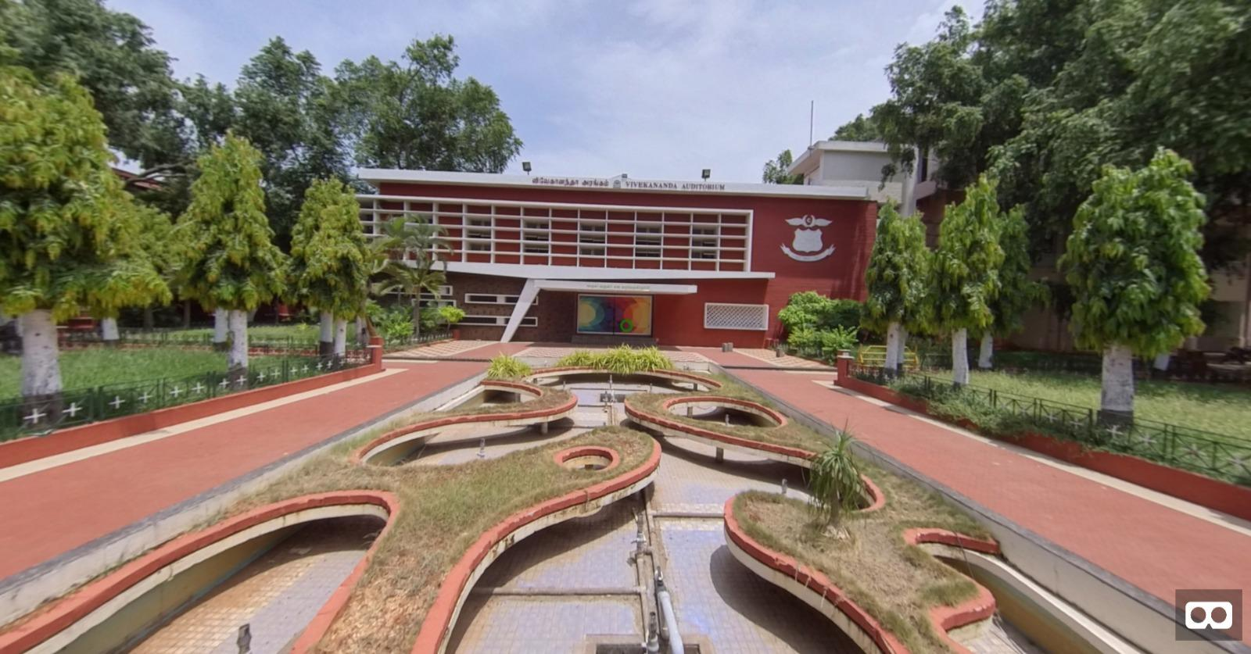
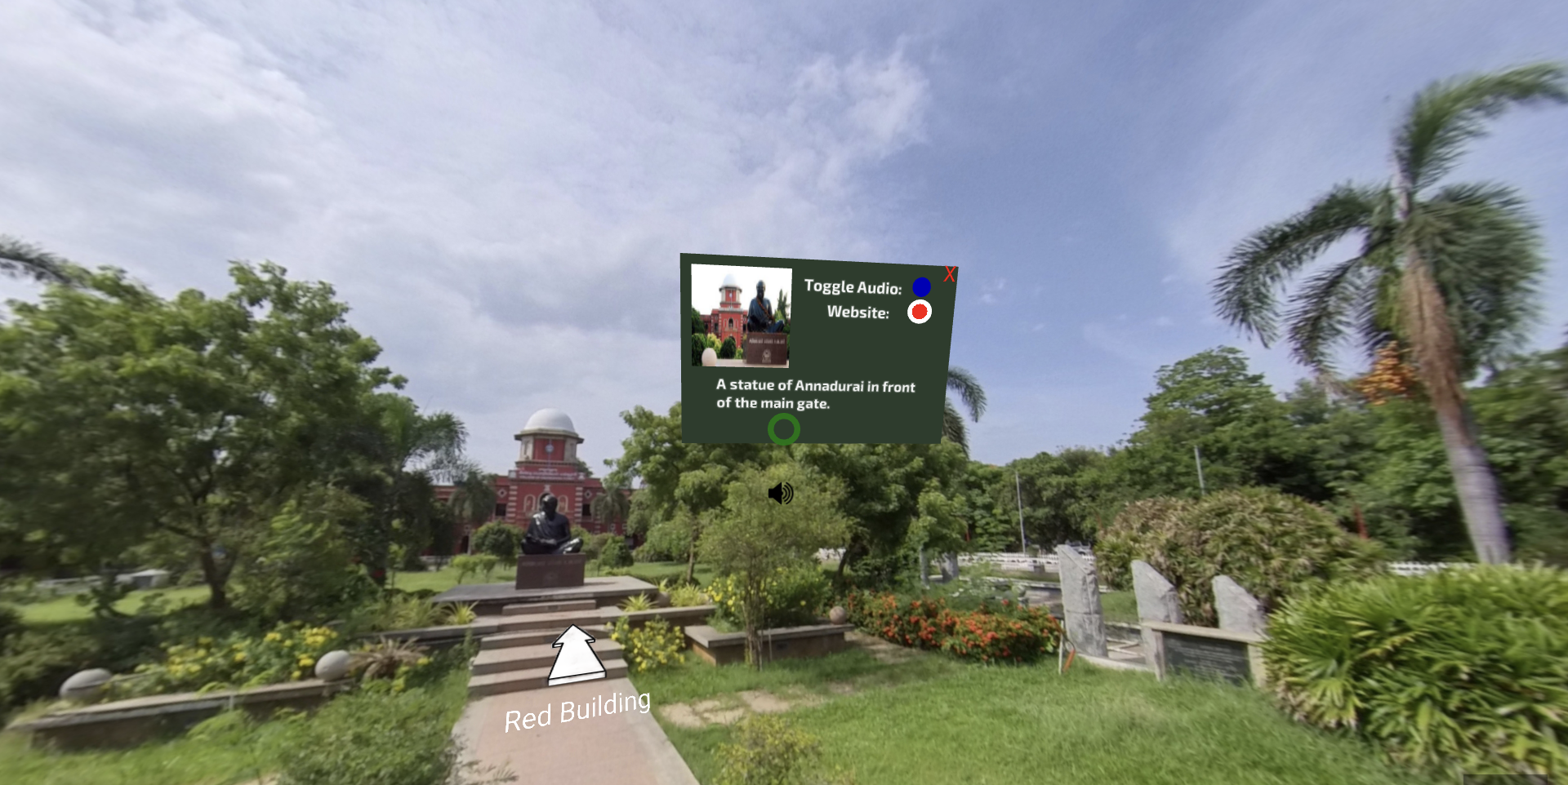
Deliverables

